Slide 1

Manu Benny
Rajesh Bhandari
Teja Sri Lakshmi Ganesh Balaji Bokka
Madeleine Breitkreutz
Atif Harshad
Jannis Römermann
31 May 2023
Team C-rious
Milestone 5

Slide 2
2/15
Content
From Conceptual Model to Simulation
  Car Source
  Probabilities
  Right-of-way Rules and yield signs
Additional Assumption
Data measured
Changes for Experiments
Cost analysis and Progress
Lessons learned

Slide 3
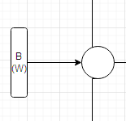


3/15
Car Source

Slide 4
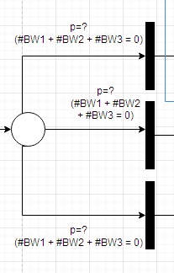
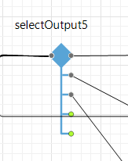
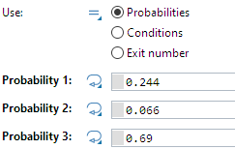
4/15
Probabilities

Slide 5
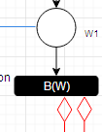
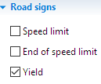
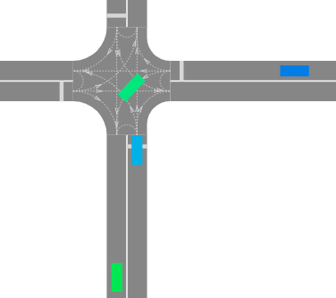

5/15
Right-of-way Rules and Yield signs
1
2

Slide 6
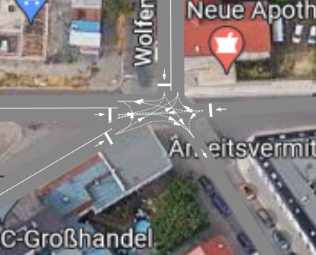
6/15
Complete Intersection Model

Slide 7
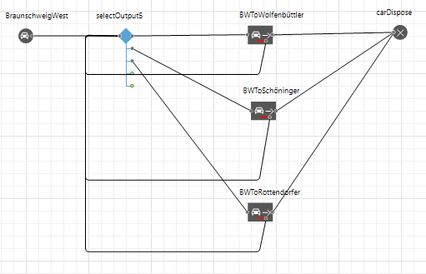
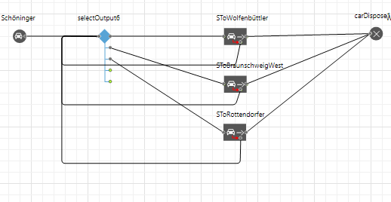
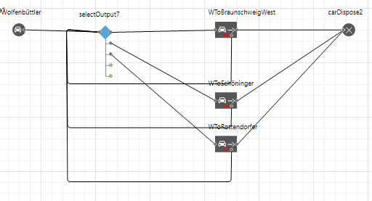
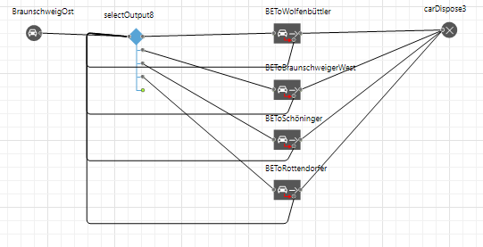
7/15
Logic

Slide 8

8/15
Additional Assumptions
Each street has a speed limit of 30 km/h, which ends at the intersection, only the braunschweigerstr. W has a small section with 50 km/h in front of the intersection
  Changing the speed limit for the whole intersection to 30 km/h

Slide 9
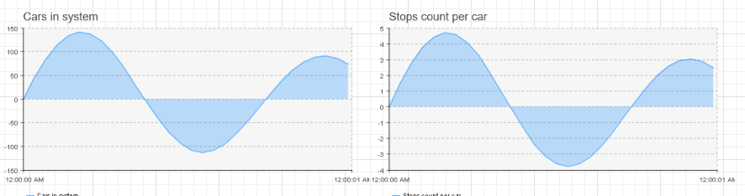
9/15
Data measured

Slide 10
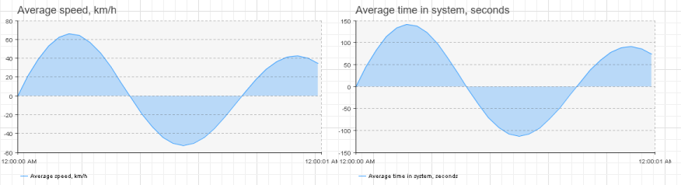
10/15
Data measured

Slide 11
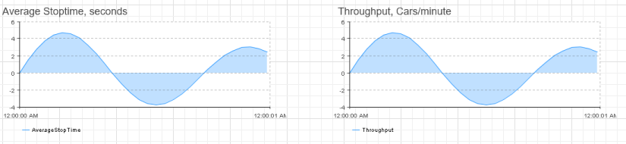
11/15
Data measured

Slide 12

12/15
Changes for Experiment
Replace the intersection with a roundabout by modelling a new simulation and use Logic from original
Changing Rottendorferstr./Braunschweiger str. E to two-way street by unselecting one-way

Slide 13
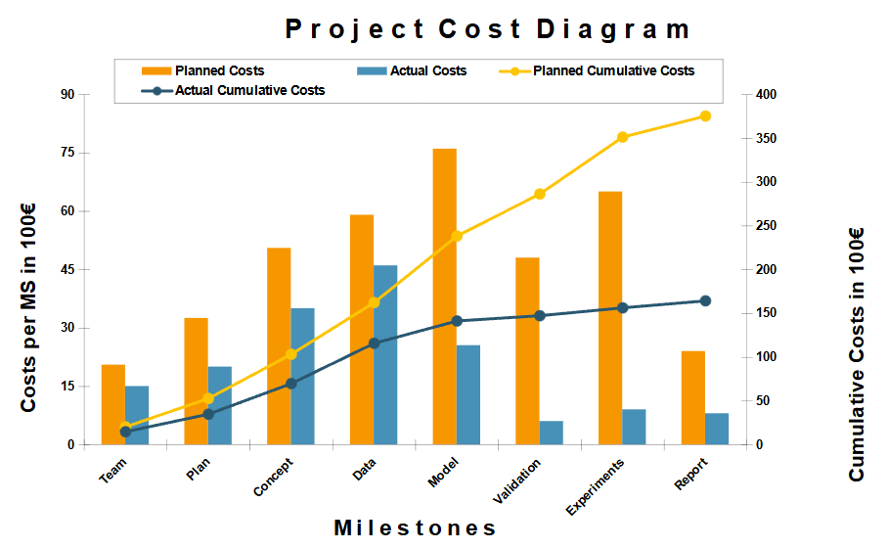
13/15
Cost Analysis

Slide 14
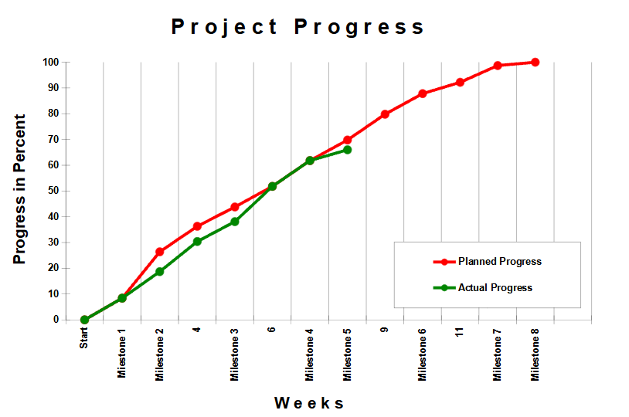
14/15
Project Progress

Slide 15
15/15
Lessons Learned
Getting to understand Anylogic is important and takes time
Debugging may take longer than expected

